Slide 1
DATA LINK LAYER
Module 2

Slide 2
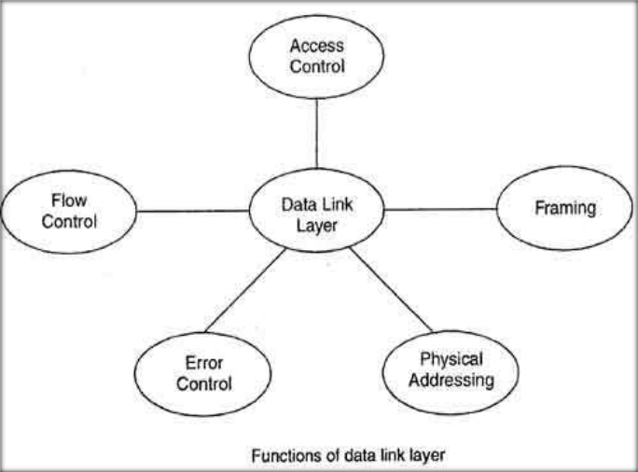
DATA LINK LAYER
Manages the Flow of Data over physical medium
Responsible for error-free transmission over the physical layer
Assures error-free data submission to the Network Layer
Notes:
Data Preparation and Exploration

Slide 3
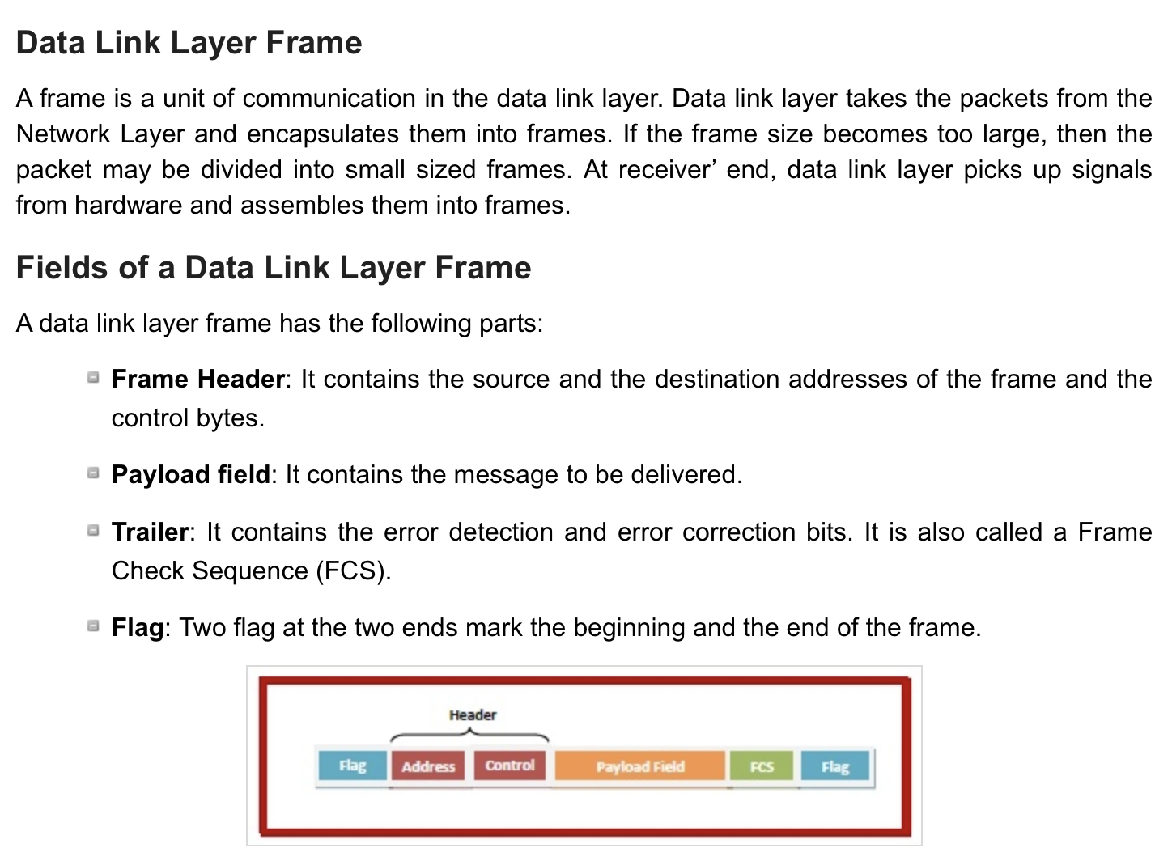

Slide 4
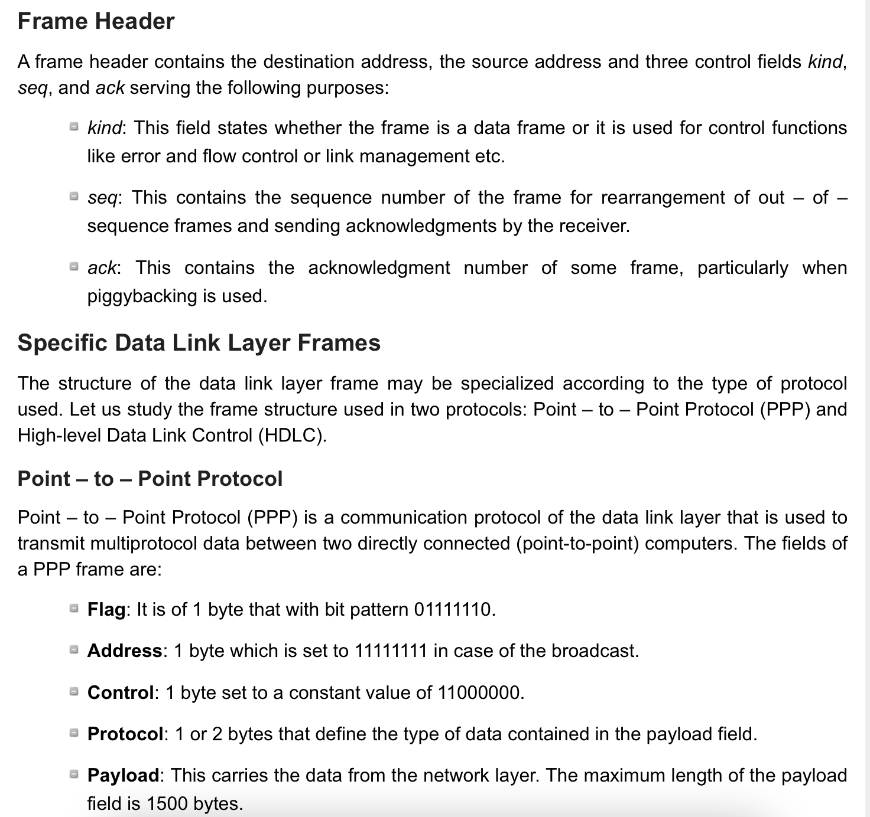

Slide 5
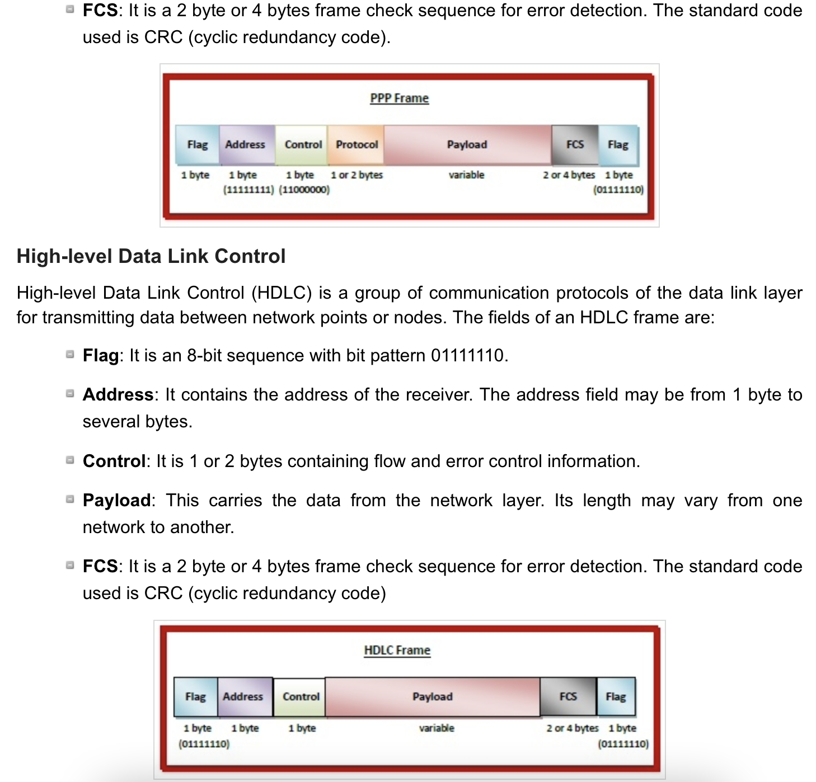

Slide 6
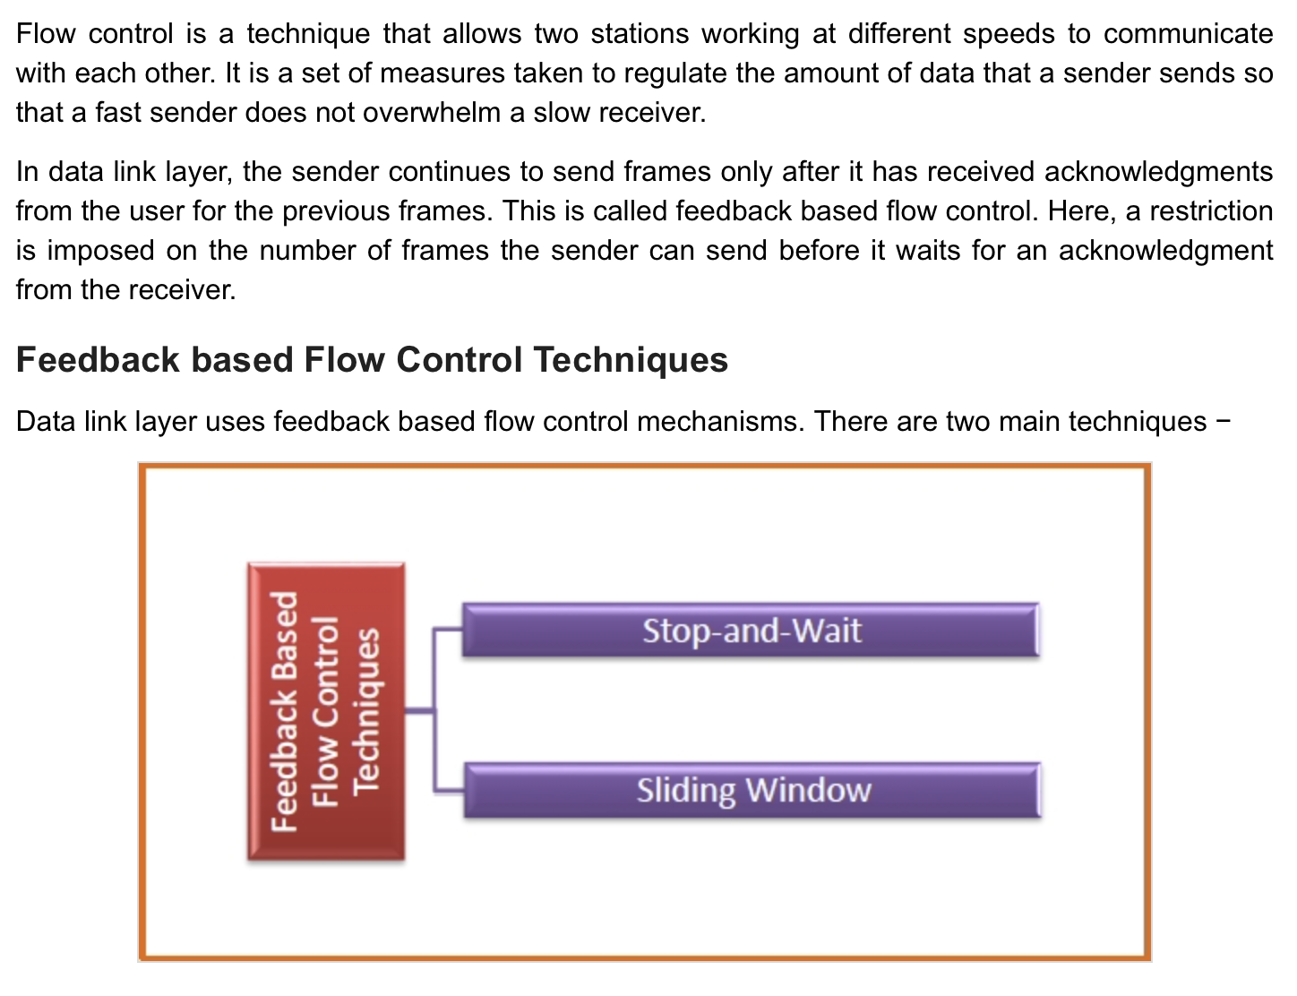

Slide 7
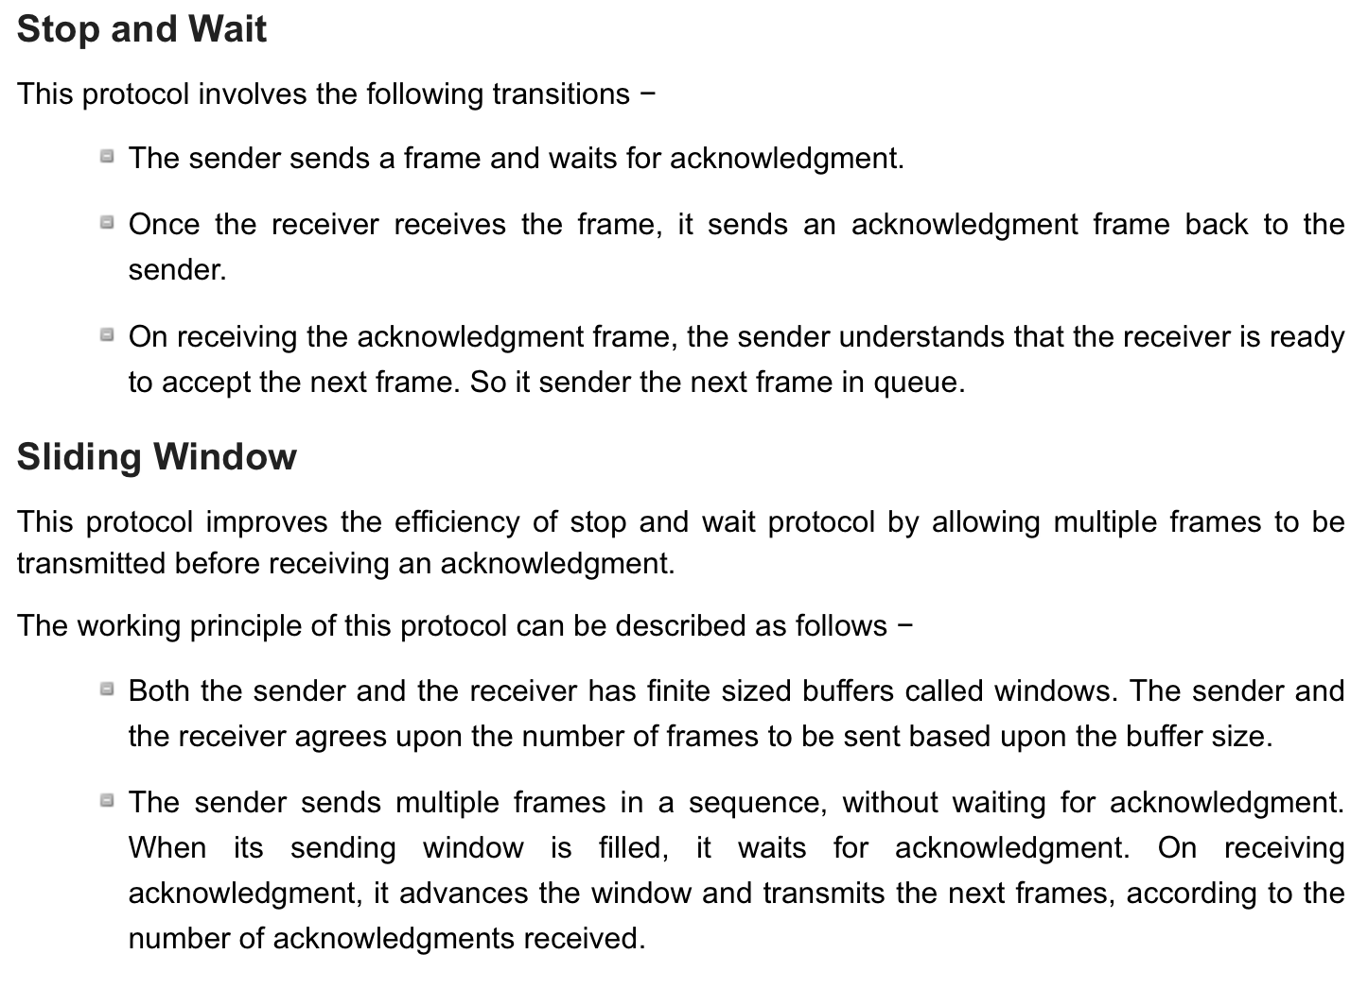

Slide 8
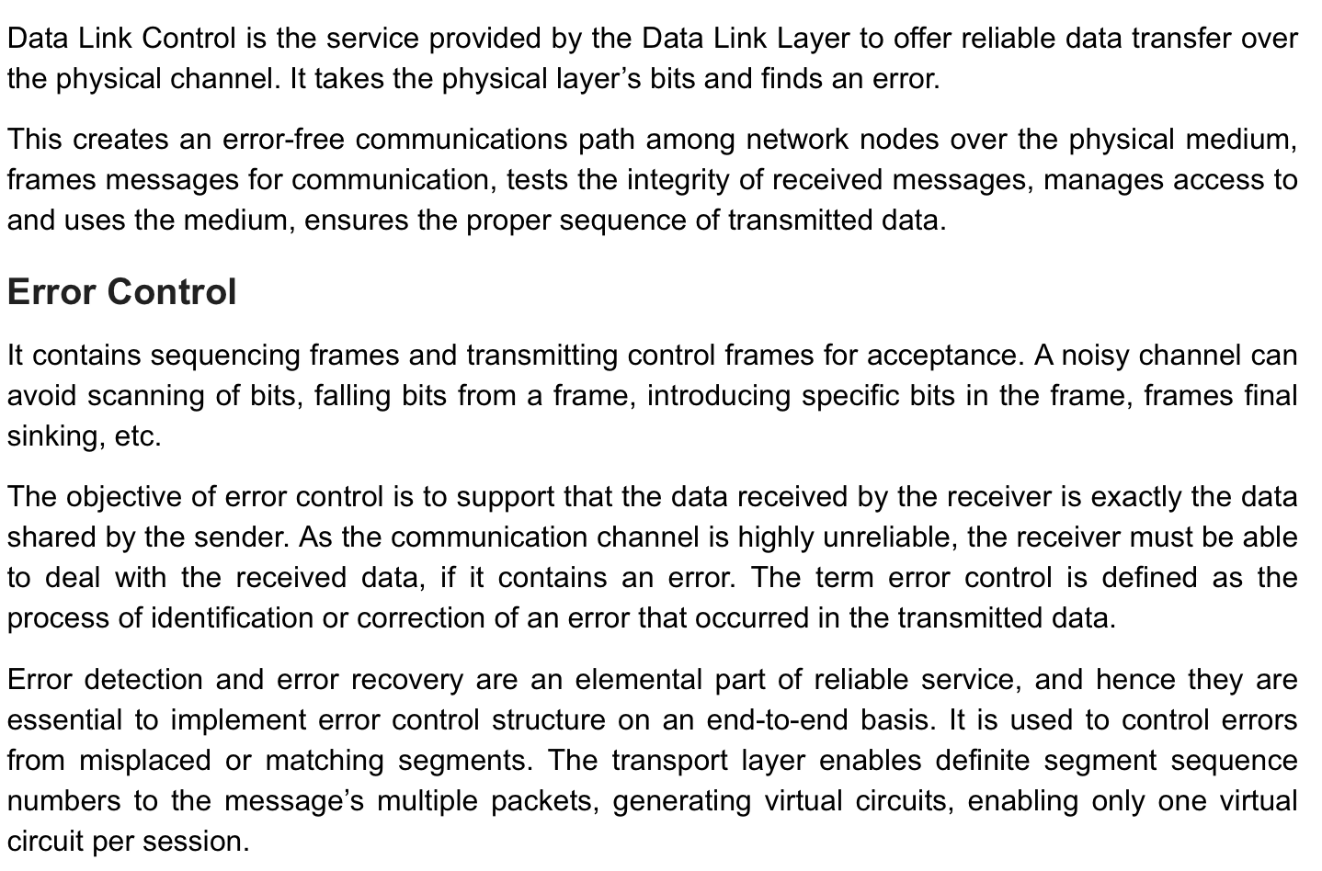

Slide 9
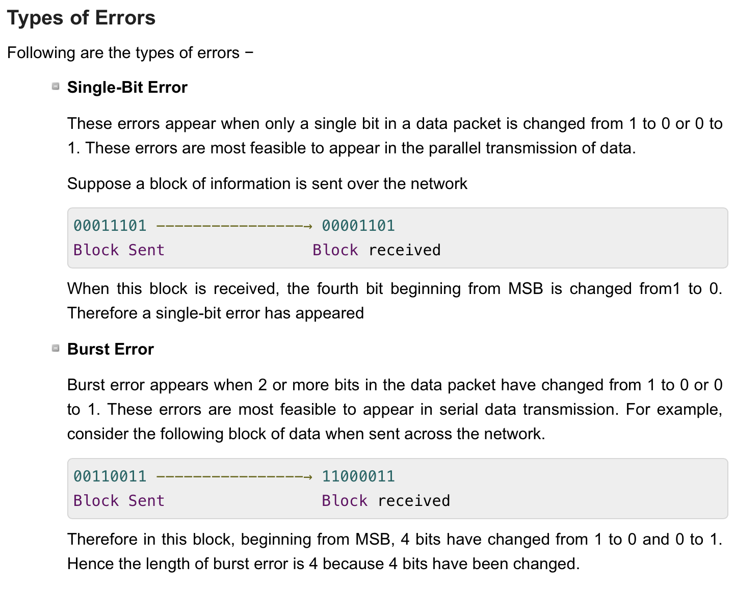

Slide 10
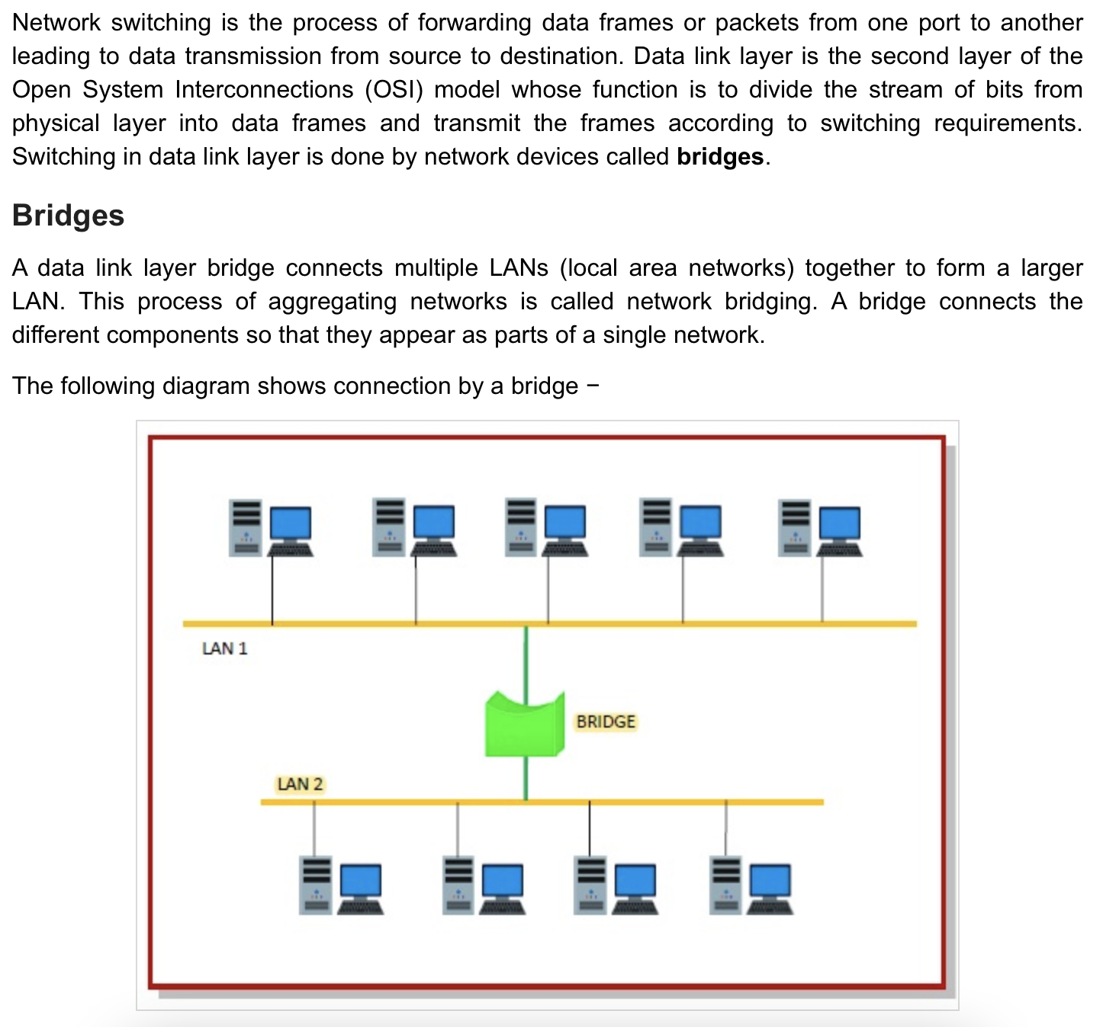

Slide 11
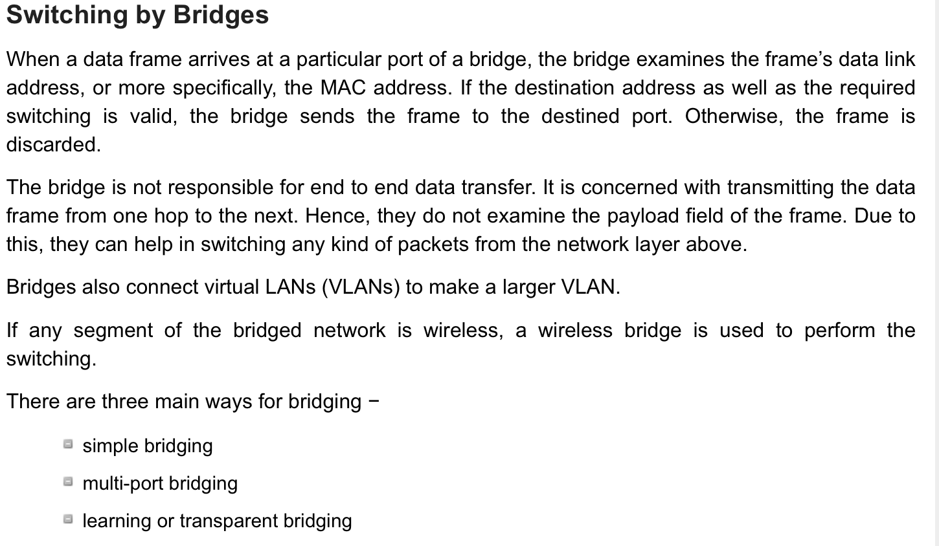

Slide 12

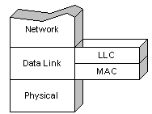
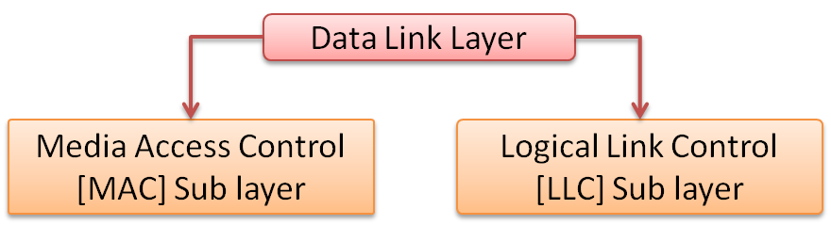
SUB LAYERS OF DATA LINK LAYER

Slide 13
Address the Frame
Its Lower Layer
Logic Link Control
Prepares the data for transfer
Its Upper Layer

